Slide 1



Using LESS for more maintainable, semantic, and lean web sites
Keith Zantow

Slide 2
Outline
Introduction to LESS
Tools and usage
Features in detail
Enabling leaner HTML

Slide 3
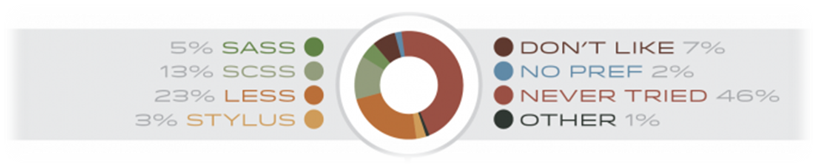
What is LESS?
  “The dynamic stylesheet language”… huh?
  Most popular CSS preprocessor
Based on CSS
Compiles to CSS
  Server-side & client-side
Adds sorely needed maintainability features
lesscss.org
Developed by Alexis Sellier (cloudhead)
Notes:
What does the dynamic stylesheet language mean?... New stuff, certainly: guards, parameter matching

Slide 4
Why use LESS?
Code reuse (DRY)
More maintainable
Easier to read – the structure more closely resembles corresponding HTML
Superset of CSS – low barrier of entry
Better browser compatibility
Written in JavaScript – portable!
You’re a hipster
Fun! No, really, it is – it’s what CSS should be!

Slide 5
Pitfalls
No standards
  W3C adopt LESS!
Browser error/inspection doesn’t match original code
Not a silver bullet to solve browser compatibility issues
  Developers still able to mess things up pretty bad
  CSS bloat
  Excessive CSS size if you’re not careful
  Potential browser performance issue
Error reporting could be better
Notes:
Dev tools

Slide 6




Integration with…
Bootstrap
Rails
Tapestry
ASP.NET
Node.js
PHP
Django
Play
…
Anything!

Slide 7
Extras: Mixin Libraries
LESSHAT
Lots of Love for LESS
LESS Elements
Bootstrap!

Slide 8
TOOLS AND USAGE
Notes:
Talk about some ways are more convenient than others

Slide 9
Usage: Integrated
Best: native framework integration
  Compilation handled automatically
JavaScript engines: V8, Rhino, Nashorn
  E.g. any Java/JVM based language
Alternate implementations
  PHP, Python, Ruby (originally)…
Edit LESS files directly, automatically converted to CSS
Browser should get optimized, compressed CSS

Slide 10
Usage: Tools
Edit LESS files, convert to CSS
Use tools when no native integration is available
Must recompile “manually” if LESS files are modified
  Keep generated CSS in version control – compression results in full-file changes – ick!
  Add to build pipeline? Limited support..
  Typically run in the background and automatically update CSS when LESS files are changed
Browser should get optimized, compressed CSS

Slide 11
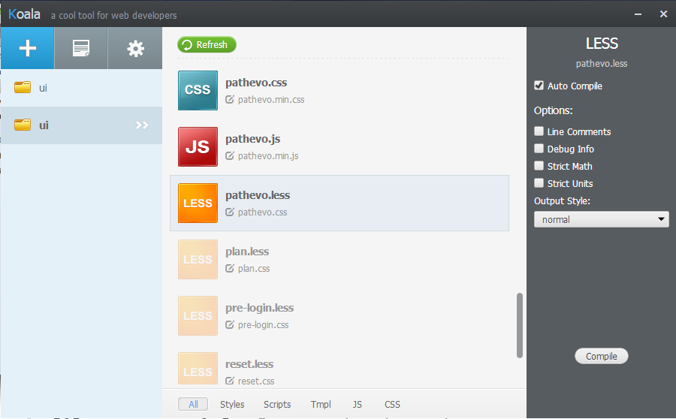
Tools: Koala
Cross-platform
SASS
LESS
JS
Coffeescript
Minify
LESS 1.5!

Slide 12
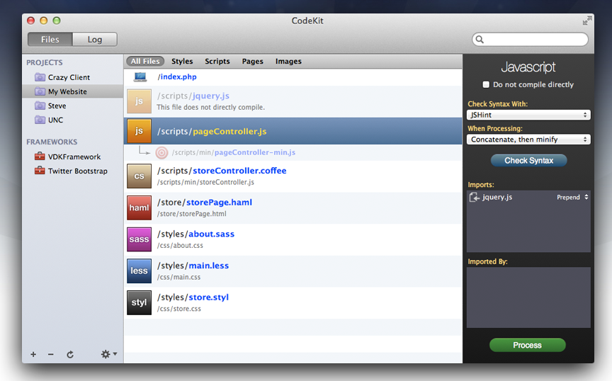
Tools: CodeKit
MAC only
SASS
LESS
JS
Coffeescript

Slide 13
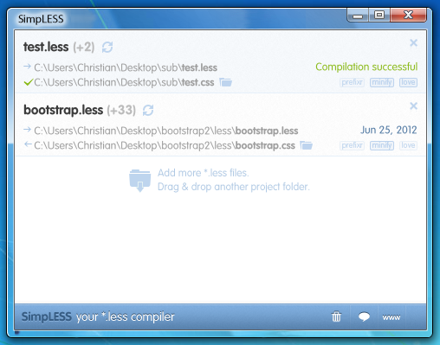
Tools: SimpLESS
Cross-
platform
LESS only
Issues with
LESS > 1.3?
Otherwise,
great

Slide 14
Tools…
Lots more…
  See the lesscss.org site for some of them
Node.js command line: lessc

Slide 15
Usage: In-Browser
Directly edit LESS files
Browser downloads LESS files directly
Compilation to CSS done via JavaScript
Use <link rel=“stylesheet/less”
Use inline <style type="text/less">
Most risky
Slowest
Development mode!

Slide 16
Usage: In-Browser
Easiest way to get started! (Don’t do this in production!)
<!doctype html>
<html>
<head>
<meta charset="UTF-8">
<style type="text/less">
@h1color: red;
body > h1 { color: @h1color; }
</style>
<script type="text/javascript"
src=“https://cdnjs.cloudflare.com/ajax/libs/less.js/1.7.4/less.min.js">
</script>
</head>
<body><h1>Hello, LESS</h1></body>
</html>

Slide 17
LANGUAGE DETAILS

Slide 18
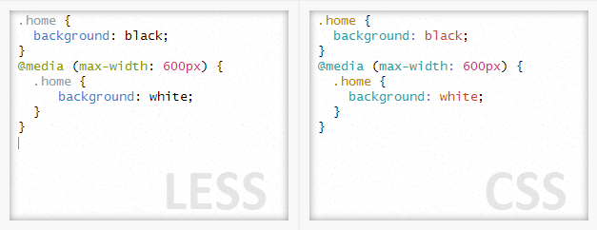
Basic Structure
Superset of CSS
Valid CSS should be valid LESS
    Imperfect?

Slide 19
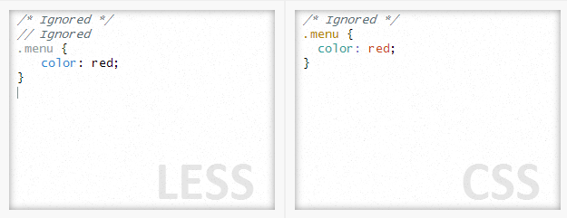
Comments
CSS-style comments
  Included in output by default
C-style single-line comments, too!!

Slide 20
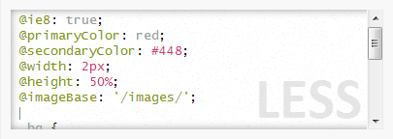
Variables
Define variables beginning with @
  My only gripe!
@var: value; syntax
Can hold different types of units, LESS is smart about units: px, em, hex/RGB colors

Slide 21
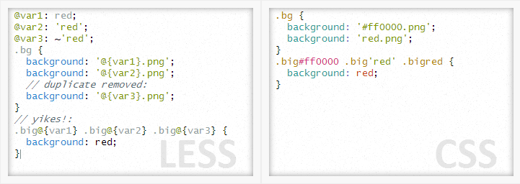
Variable Interpolation
Variables interpolated in strings
Make sure you know your data type!
Interpolated in selectors & rules
Must use the @{var} syntax

Slide 22
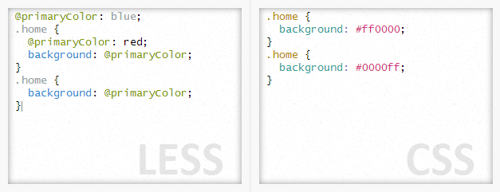
Variable Scope
Variables scoped logically within braces
Variables from mixins available in scope where used

Slide 23
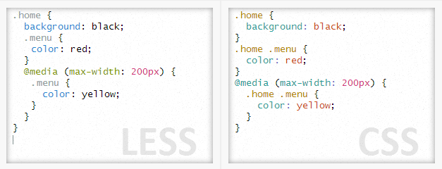
Nesting
LESS allows nested selectors
Compiled logically to combine selectors in resulting CSS
@media handled appropriately

Slide 24
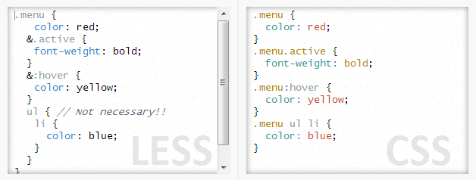
Nesting
Ampersand used to concatenate to parent selector
  Will concatenate just about anything
Easy to nest too deep – not necessary to mimic HTML

Slide 25
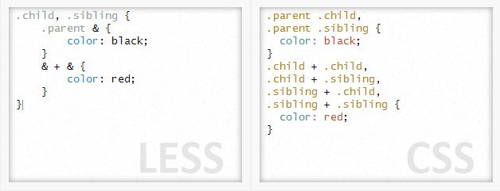
Nesting
Ampersand also used to “reverse nesting order”
  .parent & will actually go at the beginning, not reversed order – better!
  Old browser support

Slide 26
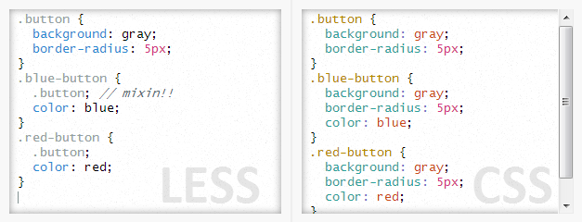
Mixins
Mixins will copy style information into context
One of the most important features to avoid duplication

Slide 27
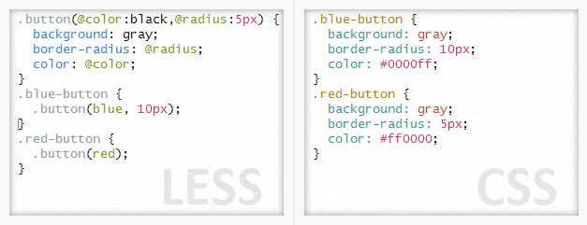
Mixins
Mixins support parameters
Default values
Variables can be scoped within mixin definition

Slide 28
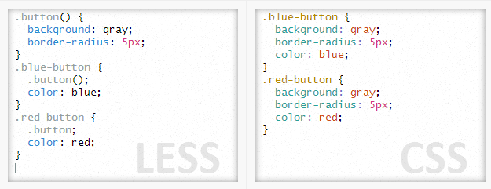
Mixins
Parameterless mixins are hidden from output
More complicated usage scenarios supported
  Nested mixins ‘unlocked’ with scoped variables…

Slide 29
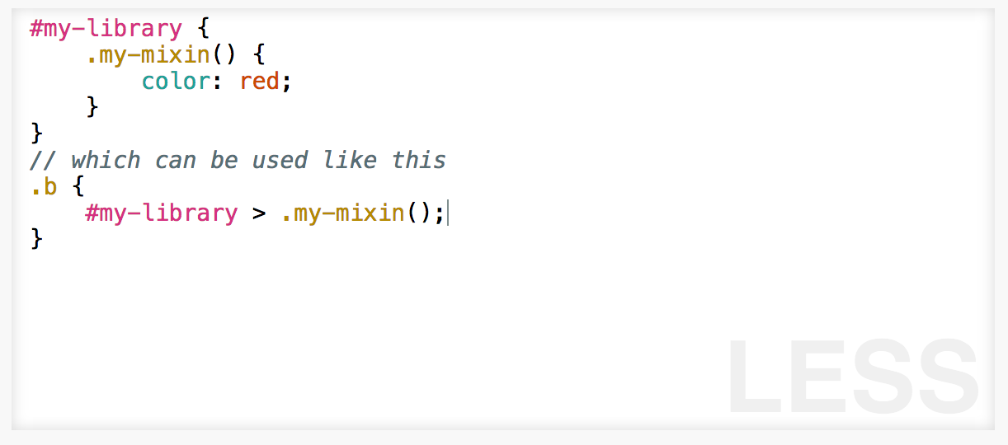
Namespaces
Enclose rules in namespaces
  Use hidden mixins to keep from output

Slide 30
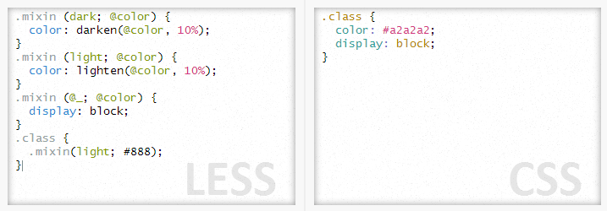
Pattern matching
Mixins matched based on critera
@_ for any value, will always be included
Match on parameter count
I’ve never had a need for this…

Slide 31
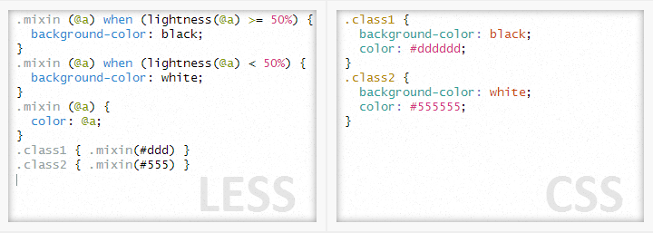
Guards
Basic inclusion/exclusion rules for mixins
Uses the when keyword after mixin declaration
Also: when (isnumber(@a)) and (@a > 0) { ... }

Slide 32
Guards
Supports: > >= = =< <
And functions:
  iscolor
  isnumber
  isstring
  iskeyword
  isurl
  ispixel
  ispercentage
  isem
  Isunit
I’ve never had a need for this, either… not a hipster!

Slide 33
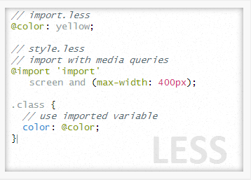
Imports
@import both CSS and LESS files
Omit .less extension, if desired, for LESS files
CSS files not processed
Imports make variables available in context

Slide 34
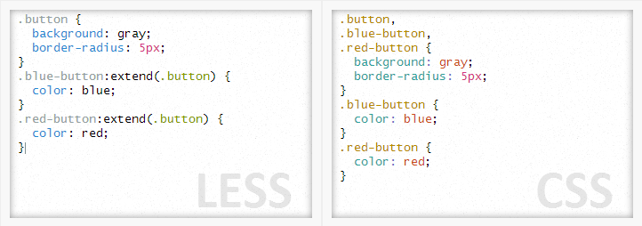
:extend
Joins to existing style rules – a way out of CSS bloat by adding selectors to parent definition
Introduced in LESS 1.4
  Last remaining deficiency vs. SASS? !!
Can’t have parameters like mixins

Slide 35
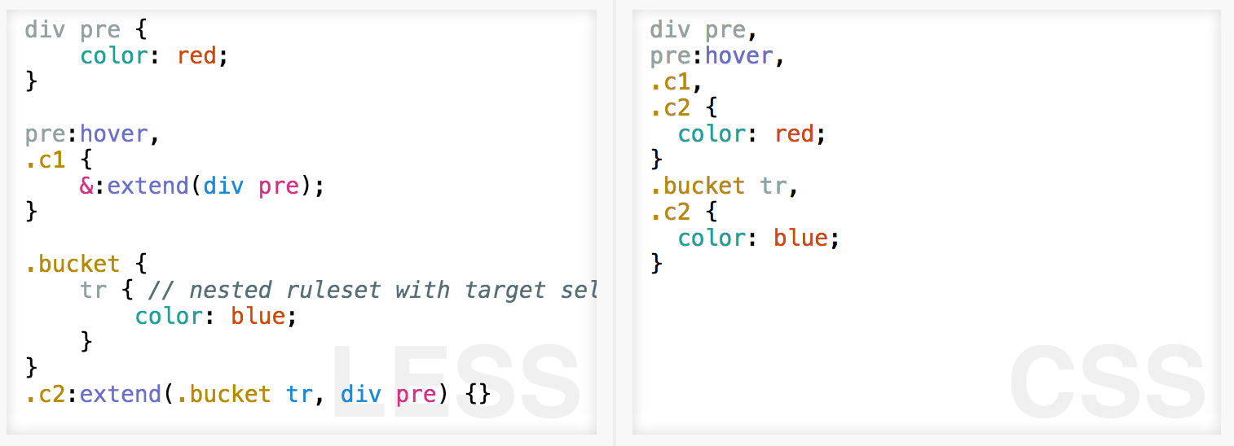
:extend
Extend matches all outputs of specific params
Extend multiple comma sparated

Slide 36
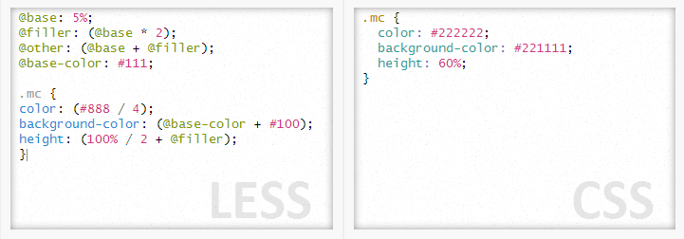
Operations
LESS is smart about math
  Units remain intact, can mix some types
  Can use hex color values in operations

Slide 37
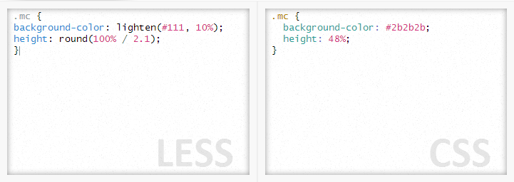
Functions
Lots of built-in functions
Color:
  lighten, darken, desaturate, …
Math:
  ceil, floor, round, …
See lesscss.org for more information

Slide 38
LEAN HTML

Slide 39
Why lean HTML?
Performant web sites
  Lean HTML
Mobile device friendly
  Smaller downloads
  Fewer DOM elements
What about full-blown AJAX sites?
  Easier to generate with JS

Slide 40
Why lean HTML?
Easier to restyle – content separated from styling
  Good for multiple developers
Philosophical change:
  Include appropriate HTML
    Think in terms of components
    Aligns with recent development:
      Angular, React, etc..
  Avoid including styling information
LESS enables this by moving styling to CSS

Slide 41


CSS Anti-patterns
Styling directly included in markup
Solution?
  renaming CSS classes, do not change usage patterns

Slide 42
CSS Anti-patterns
Regardless of the terminology, style information is directly included in the markup
Why?
  It would require lots of duplicate CSS to do otherwise
Grid systems - eek!
  Chock full o’ anti-patterns

Slide 43
Maintainability
Avoid needless classes
  Avoid lots of unnecessary nesting
  Modern browsers make styling much easier
Include lean HTML
Never use IDs, at least not for styling
  No performance benefit

Slide 44
Target & Apply
Target (use selectors)
  This is what CSS is built for
  You already know jQuery & CSS selectors, right?
Apply style rules
  In your CSS, marry the targeted elements to the styling information
  This is what LESS makes easy to do!

Slide 45
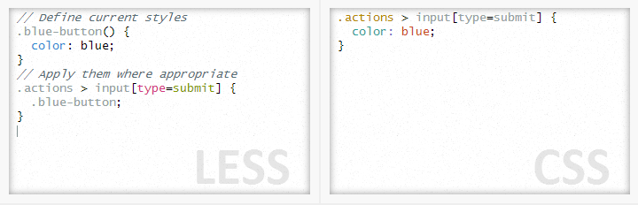
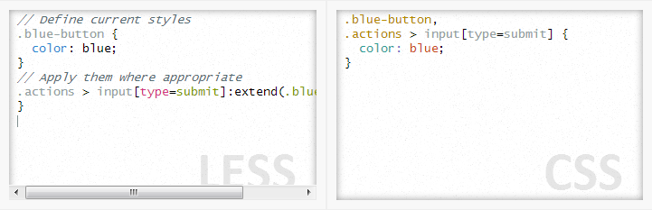
LESS for styling
Using mixins and :extend functionality, move the choice of styling to the rules, not the HTML
Based on minimal HTML, easy to apply selectors

Slide 46
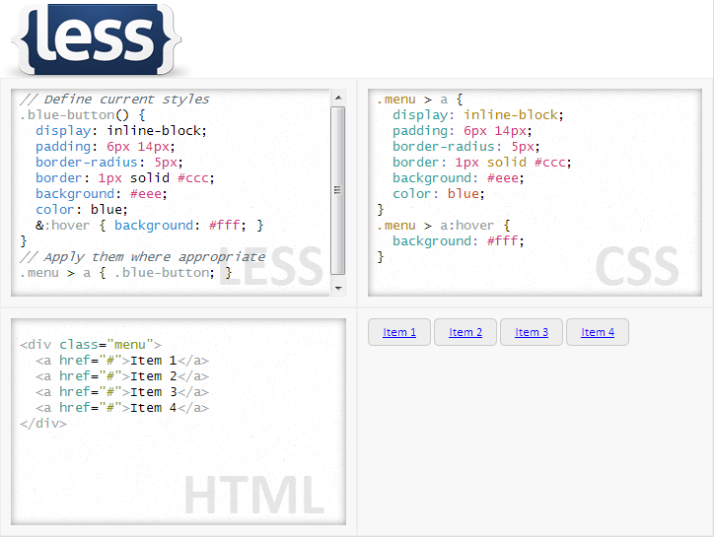
Rethink your HTML

Slide 47
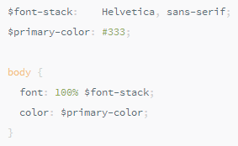
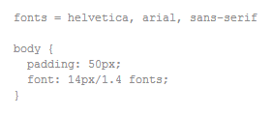
Alternatives to LESS
SASS
  SCSS similar to CSS syntax
  Compass is said to be awesome
  Old SASS syntax == bad!
  Uses $ for vars, smart!
Stylus
  Syntax “different” than CSS
Plain-old CSS
  CSS pre-processors are for hipsters!

Slide 48
Try it!
Questions? Comments?
Editor: kzantow.github.io/fiddle-less
less2css.org
Thanks!

